Slide 1

Translation as commodity or commons?
Claire Larsonneur,
University Paris 8, EA 1569 TransCrit

Slide 2
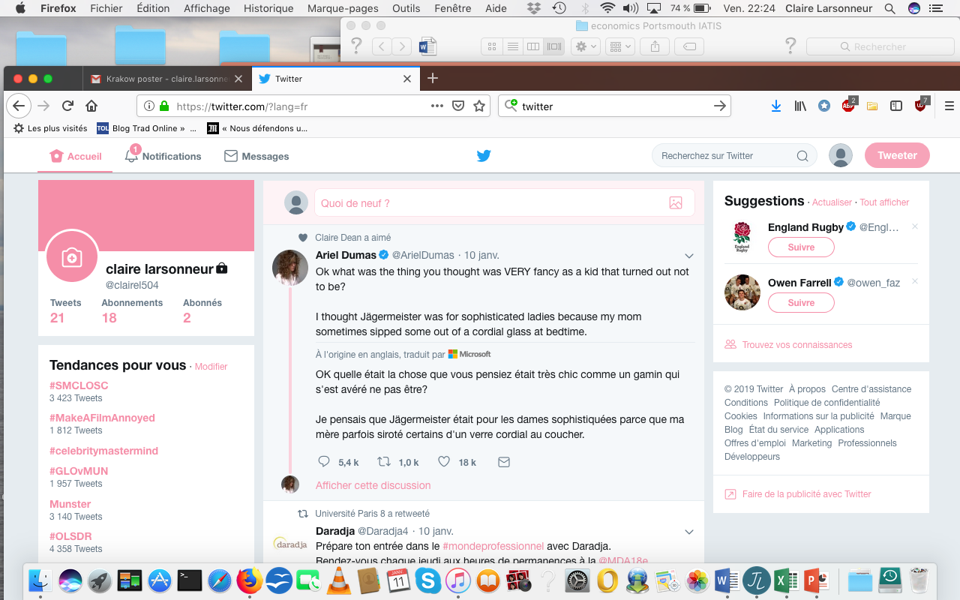
NMT everywhere
Free online basic services
Integration within online interfaces
Internet of things
Customized corporate NMT tools

Slide 3
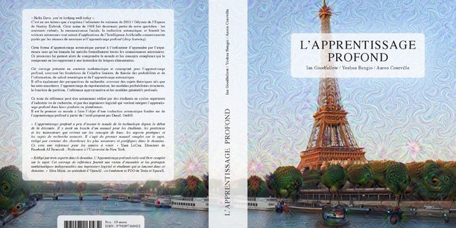
Inside the black box of automated publishing
October 2018
Quantmetry + DeepL
- 2,5 months training
- 12h translating
- revision

Slide 4
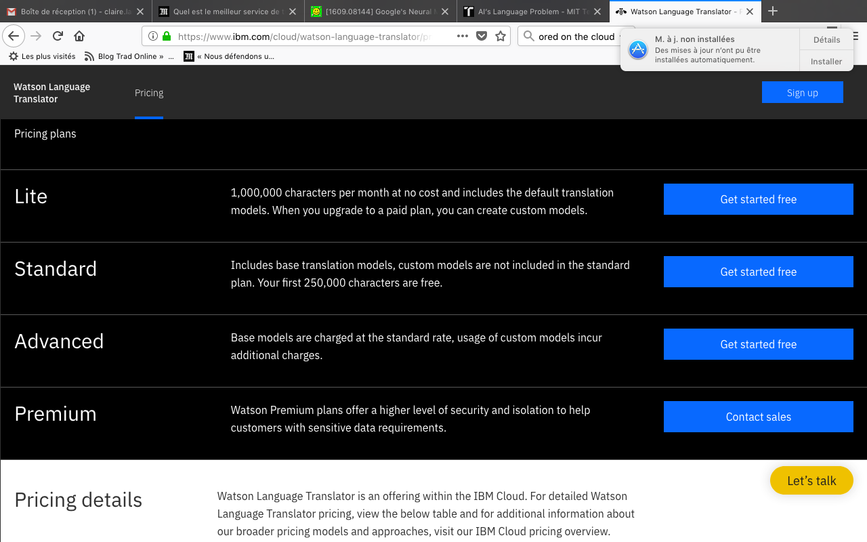
When prices go wild
Report on NMT by Slator (30p) : 85 $
200K : a customized NMT solution for a French public body
Textmaster starting at 0,06€ per word
Freemium : free + subscription

Slide 5
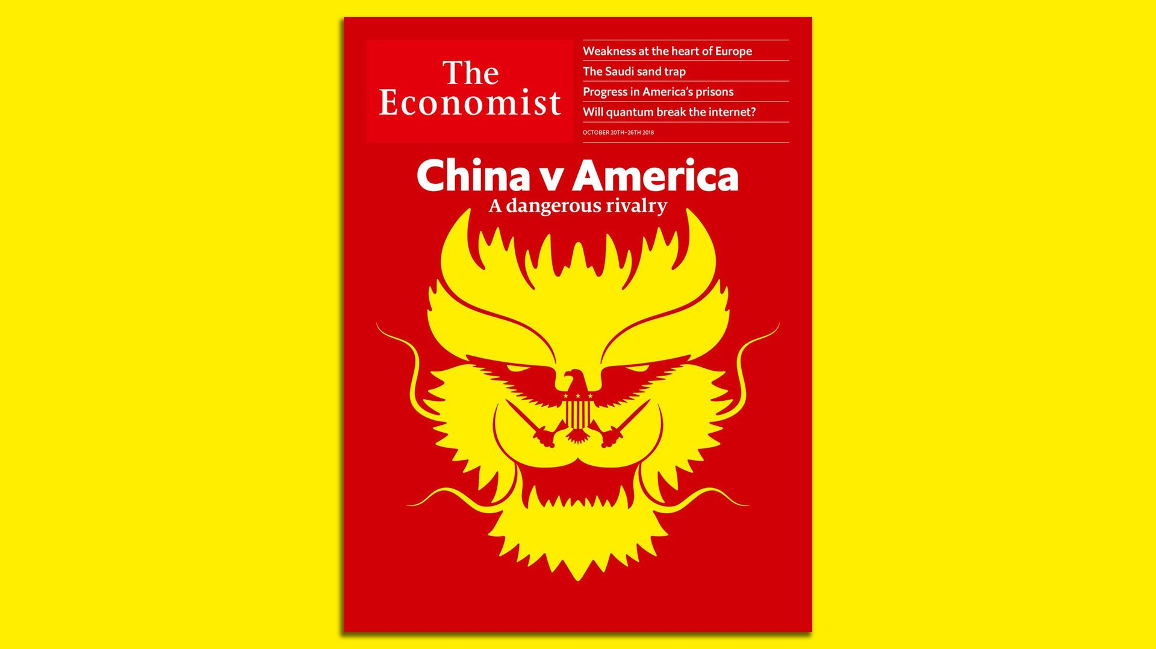
A power struggle between the US and China
% of research articles on NMT published in 2017 (sample of the 50 most relevant on Google Scholar)
Anglo-saxon institutions: 46 % (24% USA)
Asian institutions: 30% (20% China)
40% are corporate-produced or financed

Slide 6
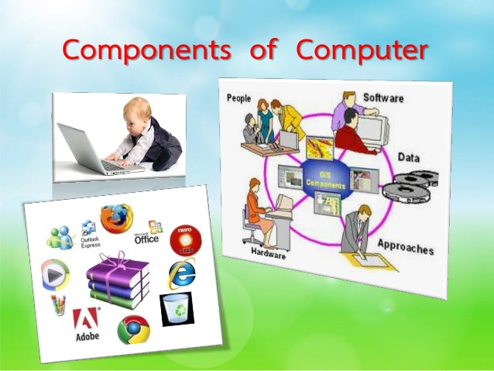
Translator’s agency?
Peopleware
In /on /out of the loop

Slide 7
The institutional gap
Sciences
Humanities
Computational linguistics, Computer science and engineering, Mathematics, physics, A.I.
SOLVING PROBLEMS, DESIGNING TOOLS
Comparative and World Literature, National literatures and Translation Studies
UNCOVERING COMPLEXITIES

Slide 8
Differing institutions, differing narratives
ergon
energeia
Circulation of agile content
Multimodal data
Language processing technologies
Text Hermeneutics
Creative practice
Philology

Slide 9
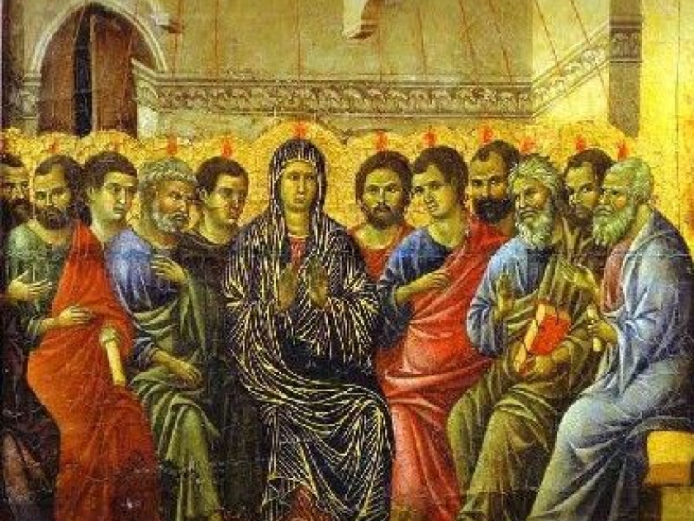
Underlying Myths: the Weight of the Bible
BABEL as a punishment
PENTECOST as a ideal
Language differences should be invisible and are not considered “safety-critical” (unlike health, crime, transportation).

Slide 10
Language matters
Marcello Vitali-Rosati: eco-systems
Yves Citton: homogeneisation of attention, value of diversity, premediations
Karen Barad: the notion of mattering
Hess & Orstrom : knowledge as a commons

Slide 11
Commodity or commons ? The partnership on AI
Established late 2016
For profit and non-profit organizations
“best practices for the ethics, safety, fairness, inclusiveness, trust, and robustness for AI research, applications, and services.”

Slide 12
Commodity or Commons? the EU
Directive “Language Equality In The Digital Age”, Sept 11, 2018
Directive “Copyright In The Digital Single Market”, Sept 12, 2018
General Data Protection Regulation, enforced May 2018

Slide 13
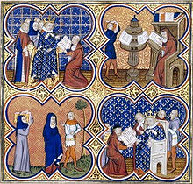
The commons : a hotbed of ideas
Sharing content/tools (creative commons)
Open access
Redistributing power among stakeholders
“Winner supports all” : redistributing values to communities
Going beyond the notion of goods or services to value attention or diversity

Slide 14

Regulation suggestions
Keeping the source text accessible on interfaces and social media
Deleting submissions and translations after 24h (like the EU)
Enabling variants
Flagging translation issues such as sensitive words/phrases (nation, gender, identity, liberal) or untranslatables
Addressing scale issues (Citton)
Imposing fiduciary obligations (Godwin) : confidentiality, loyalty, non negligence

Slide 15
Thank you for your attention
Claire.Larsonneur@univ-paris8.fr
Academia.edu, Researchgate, LinkedIn, EA 1569
Claire.larsonneur@univ-paris8.fr

